Slide 1
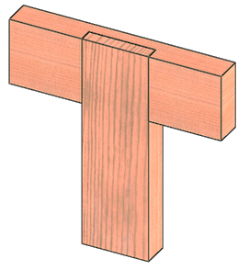
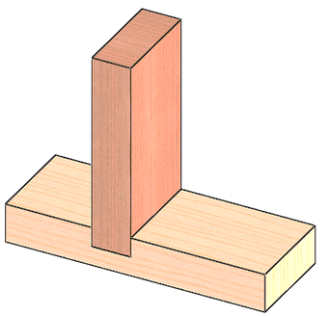
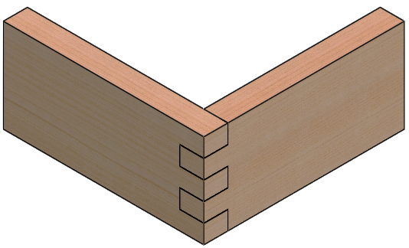
Woodworking Joints.
Sketching/Information Sheets.
(Use a pencil to sketch an Exploded view of each joint in the boxes provided)
Joint: __________________________________
Joint Information: ____________________________________________________________________________________________________________________________________________________________
Joint: __________________________________
Joint Information: ____________________________________________________________________________________________________________________________________________________________
Joint: __________________________________
Joint Information: ____________________________________________________________________________________________________________________________________________________________

Slide 2
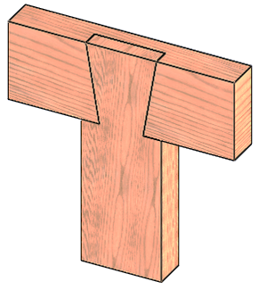
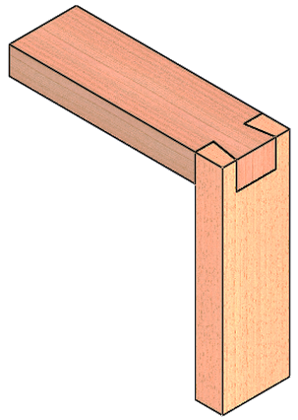
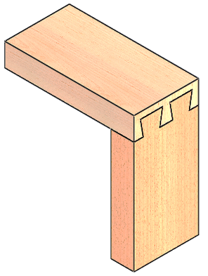
Woodworking Joints.
Sketching/Information Sheets.
(Use a pencil to sketch an Exploded view of each joint in the boxes provided)
Joint: __________________________________
Joint Information: ____________________________________________________________________________________________________________________________________________________________
Joint: __________________________________
Joint Information: ____________________________________________________________________________________________________________________________________________________________
Joint: __________________________________
Joint Information: ____________________________________________________________________________________________________________________________________________________________

Slide 3
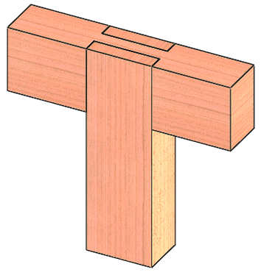
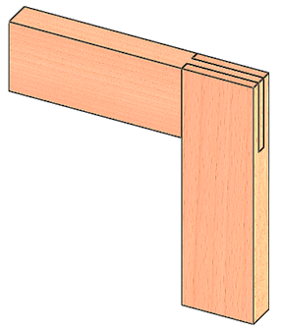
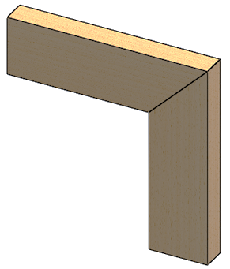
Woodworking Joints.
Sketching/Information Sheets.
(Use a pencil to sketch an Exploded view of each joint in the boxes provided)
Joint: __________________________________
Joint Information: ____________________________________________________________________________________________________________________________________________________________
Joint: __________________________________
Joint Information: ____________________________________________________________________________________________________________________________________________________________
Joint: __________________________________
Joint Information: ____________________________________________________________________________________________________________________________________________________________

Slide 4
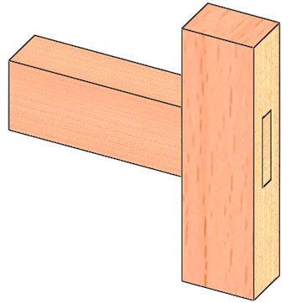
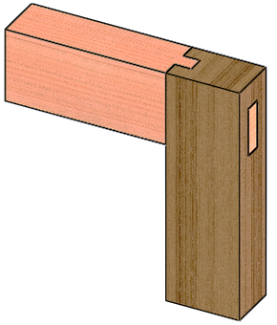
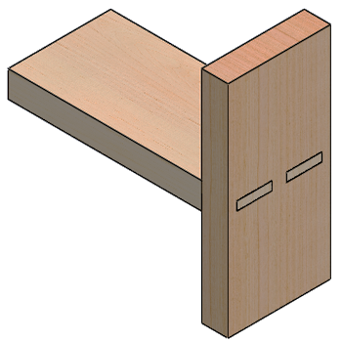
Woodworking Joints.
Sketching/Information Sheets.
(Use a pencil to sketch an Exploded view of each joint in the boxes provided)
Joint: __________________________________
Joint Information: ____________________________________________________________________________________________________________________________________________________________
Joint: __________________________________
Joint Information: ____________________________________________________________________________________________________________________________________________________________
Joint: __________________________________
Joint Information: ____________________________________________________________________________________________________________________________________________________________

